Slide 1
REFRESHER COURSE
ON
DATA STRUCTURE CONCEPTS
Ms. Gunjan Mathur, Lecturer, Amrapali Institute of Applied Sciences

Slide 2
TOPICS TO COVER
Overview of Data Structure
Pointer
Structure
Linked list
Introduction to Tree

Slide 3
Data Structure
Data structure is a particular way of storing and organizing data in a computer so that it can be used efficiently.
In programming, the term data structure refers to a scheme for organizing related pieces of information.

Slide 4
TYPES OF DATA STRUCTURE
Linear
In linear data structure, member elements form a sequence.
For e.g.- Stack, Queue
Two basic strategies for representation in memory:
Array
Linked List
Non – Linear
In which the data items are not arranged in a sequential structure. For e.g. - Tree, graph
Two basic strategies for representation in memory:
Array
Linked List

Slide 5
TYPES OF MEMORY ALLOCATIONS
Static
Static memory allocation refers to the process of allocating memory at compile-time before the associated program is executed.
Like in ‘C’: int i;
Dynamic
In Dynamic memory allocation memory is allocated as required at execution-time using functions like:
malloc() and calloc()

Slide 6
ARRAY
STATIC MEMORY ALLOCATION
Array is a collection of similar/homogenous data stored under unique name.
Declared as
  <data type> <array_name> [index/size]
  For e.g – int myarray[10];

Slide 7
TYPES OF ARRAY
Single dimension
The array which is used to represent and store data in a linear form is called as 'single or one dimensional array.‘
Example:
int a[3] = {2, 3, 5};
char ch[20] = "TechnoExam";
N - dimension
The array which is used to represent and store data in a logically tabular form is called as ‘n dimensional array’.
Example:
int a[2][2][3] = {1, 2, 3, 4, 5, 6, 7, 8, 9,
10, 11, 12};

Slide 8
LINKED LISTS
Dynamic memory allocation
A linked list consists of:
  A sequence of nodes
myList
a
b
c
d
  Each node contains a value
and a link (pointer or reference) to some other node
The last node contains a null link

Slide 9
LINKED LISTS
A node’s successor is the next node in the sequence
The last node has no successor
A node’s predecessor is the previous node in the sequence
The first node has no predecessor
A list’s length is the number of elements in it
A list may be empty (contain no elements)

Slide 10
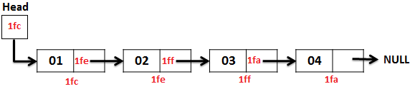
TYPES OF LINKED LISTS
Singly linked list
Begins with a pointer to the first node
Terminates with a null pointer
Only traversed in one direction

Slide 11
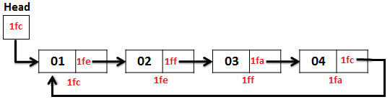
TYPES OF LINKED LISTS
Circular, singly linked
Pointer in the last node points back to the first node

Slide 12
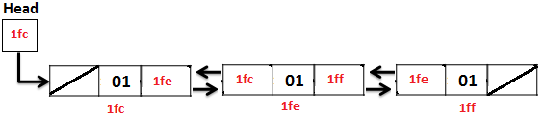
TYPES OF LINKED LISTS
Doubly linked list
Two “start pointers” – first element and last element
Each node has a forward pointer and a backward pointer
Allows traversals both forwards and backwards

Slide 13
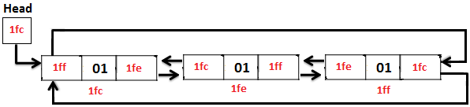
TYPES OF LINKED LISTS
Circular, doubly linked list
Forward pointer of the last node points to the first node and backward pointer of the first node points to the last node

Slide 14
FOR IMPLEMENTING LINKED LISTS WE MUST KNOW..
Pointers
Structures
Dynamic memory allocation functions

Slide 15
POINTER
Pointer is a special kind of variable which holds the address of another variable.
Pointer variables Definition
  <data type> *<ptr_name>
  example
    int *ptr;
    Char *ptr;
Pointer variables Initialization
  Example
    Ptr = &num;
    Num should be of same type as ptr

Slide 16
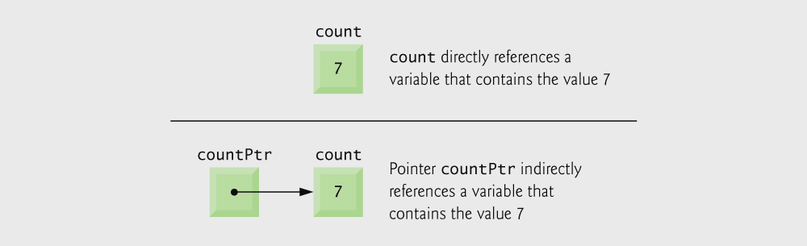
POINTER CONTINUE
int count = 7;
int *countPtr;
countPtr = &count;

Slide 17

POINTER CONTINUED
int y, *yptr;
y = 5;
yptr = &y;
To print 5 we can
  Printf (“%d”,y);
  Printf(“%d”, *yptr);

Slide 18
?
How to store more than one data in a single variable ???
How to store date ??
How to store Student information like roll no., name, marks ??

Slide 19
STRUCTURE
Structure is user defined data type which is used to store heterogeneous data under unique name.
Keyword 'struct' is used to declare structure.
Syntax:
struct structure_name
{
<data-type> element 1;
<data-type> element 2;
- - - - - - - - - - - - - - - - - - - - - -
<data-type> element n;
}struct_var;
Example :
struct emp_info
{
char emp_id[10];
char name[100];
float sal;
}emp;
Struct emp_info emp;

Slide 20
STRUCTURE
Facilitates to store compound data easily:
A date is
  an int month and
  an int day and
  an int year
struct Date {
int day;
int month;
int year;
};
struct Date date;
date.day = 9;
date.month = 1;
date.year = 2005;

Slide 21
POINTERS TO STRUCTURE
Create a variable of structure type
Create a pointer variable of structure type
Assign the address of structure variable to pointer.
We can access structure members with pointer using
->
operator.
struct Date {
int day;
int month;
int year;
};
struct Date mydate;
struct Date *dateptr;
dateptr = &mydate;
dateptr->day = 9;
dateptr->month = 1;
dateptr->year = 2005;

Slide 22
DYNAMIC MEMORY ALLOCATION FUNCTIONS
Malloc()
Allocates single block of memory and returns the address of first byte of allocated memory
Ptr = (datatype *)malloc(size)
Ptr = (int *)malloc(10);
Calloc()
Allocates multiple blocks of memory and returns the address of first byte of allocated memory
Ptr = (datatype *)calloc(n, size)
Ptr = (int *)calloc(5, 10);
Size of block to be allocated is in bytes.

Slide 23
DYNAMIC ALLOCATION OF STRUCTURE
struct node
{
  char info;
  struct node *next;
};
struct node *ptr;
To allocate a memory dynamically for node :
ptr = (struct node *)malloc(sizeof(struct node));

Slide 24
ptr = (struct node *)malloc(sizeof(struct node));
or
ptr = (struct node *)malloc(4);
This will allocate memory as -
        A container of type struct node
        A node of linked list
info
1020
ptr
*next
1020

Slide 25
code
memory
struct node
{
  char info;
  struct node *next;
};
struct node *ptr;
ptr = (struct node*) malloc(sizeof(struct node));
info
1020
ptr
*next
1020

Slide 26
LINKED LIST IMPLEMENTATION 1
#include<stdio.h>
#include<malloc.h>
#include<conio.h>
void main()
{
struct node
{
int item;
struct node *next;
};
clrscr();
struct node *start-=NULL, *ptr;
printf("\n size %d",sizeof(struct node)); //This will print 4
NULL
start

Slide 27
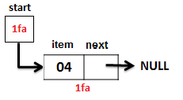
start = (struct node *)malloc(sizeof(struct node));
start->next = NULL;
printf("\n Enter any value: ");
scanf("%d", &start->item);

Slide 28
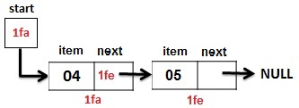
start->next = (struct node *)malloc(sizeof(struct node));
start->next->next = NULL;
printf("\n Enter any value: ");
scanf("%d", &start->next->item);

Slide 29
LINKED LIST IMPLEMENTATION 2
#include<stdio.h>
#include<malloc.h>
#include<conio.h>
void main()
{
struct node
{
int item;
struct node *next;
};
clrscr();
struct node *start-=NULL, *ptr = NULL;
printf("\n size %d",sizeof(struct node)); //This will print 4
NULL
NULL
start
ptr

Slide 30
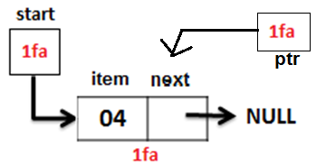
If(start = NULL){
start = (struct node *)malloc(sizeof(struct node));
start->next = NULL;
printf("\n Enter any value: ");
scanf("%d", &start->item);
ptr = start;
}

Slide 31
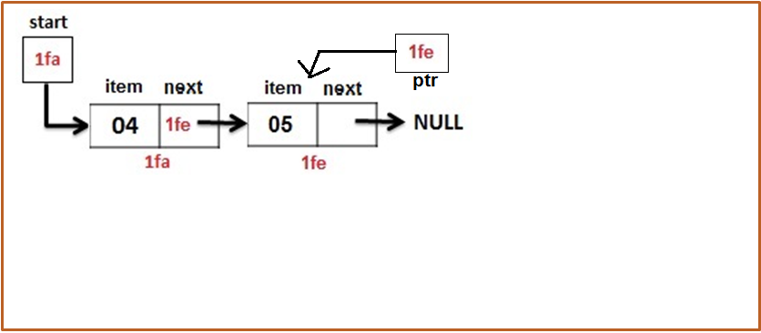
Else{
ptr->next = (struct node *)malloc(sizeof(struct node));
ptr = ptr->next;
Ptr->next = NULL;
printf("\n Enter any value: ");
scanf("%d", &ptr->item);
}

Slide 32
//traversing linked list
ptr = start;
printf("\n Linked List is : \n ");
while(ptr != NULL)
{
printf(" %d ",ptr->item);
ptr = ptr->next;
}
getch();
}

Slide 33
TRAVERSING LINKED LIST
ptr
start
one
two
three
info
next
info
next
info
next

Slide 34
LINKED LIST IMPLEMENTATION 2
#include<stdio.h>
#include<conio.h>
struct node * getnode(){
  return (struct node *)malloc(sizeof(struct node));
}
struct node
{
int info;
struct node *next;
};
void main()
{
struct node *start=NULL,*ptr;
int val;
char ch;
clrscr();
printf("\n Size of structue is %d",sizeof(struct node));

Slide 35
do{
if(start == NULL) {
start= getnode();
ptr = start;
}
else{
ptr->next = getnode();
ptr = ptr->next;
}
printf("\n Enter any value: ");
scanf("%d", &ptr->info);
printf("\n Do you want to continue: ");
fflush(stdin);
scanf("%c",&ch);
}while(ch == 'Y' || ch == 'y');
//display linked list
getch();
}

Slide 36
INSERT A NODE AFTER ANY NODE IN LINKED LIST
temp
2.5
start
one
two
three
Find the node you want to insert after
First, copy the link from the node that's already in the list
Then, change the link in the node that's already in the list

Slide 37
DELETING A NODE FROM LINKED LIST
• To delete the first element, change the link in the header
start
one
two
three
• To delete some other element, change the link in its predecessor
start
(predecessor)
one
two
three
• Deleted nodes will eventually be garbage collected

Slide 38
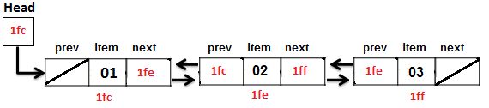
DOUBLY LINKED LIST IMPLEMENTATION
Structure of doubly linked list can be
struct node{
  struct node *prev;
  int item;
  struct node *next;
}

Slide 39
NOTE:
There are many applications in real life that are not fulfilled using linear data structure…
A family tree…
A city map…
Hierarchy..

Slide 40
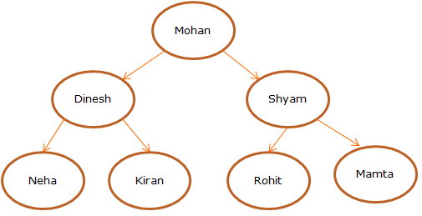
TREE
Tree is a non linear data structure. It is used to represent hierarchical relationship among data items.

Slide 41
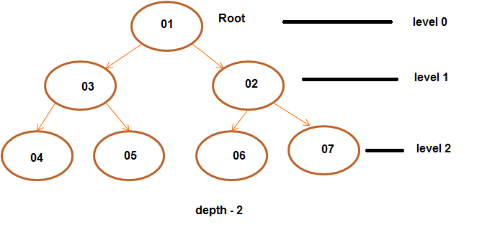
TREE TERMINOLOGY
Each data item in tree is called a Node.
First node of tree is called Root.
Starting from Root the tree has levels. Root is at level 0.
Maximum level of any node is Depth of tree.

Slide 42
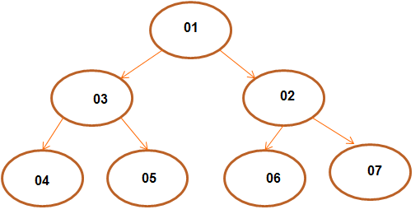
TREE TERMINOLOGY
A node having sub nodes is called parent (except root every child has one parent).
Children nodes of a given parent node are called Siblings.
Parent – 01, 02, 03
Siblings – 02,03 and 04,05 and 06,07
Nodes with no child are called Leaves – 04,05,06,07

Slide 43
BINARY TREE
No node has more than two child nodes (called child subtrees).
A node in a binary tree can have 0,1, or 2 childs or child subtrees
A data structure for efficient searching, insertion and deletion
Notes:
E.g. – telephone directory

Slide 44

BINARY SEARCH TREE
A binary search tree is a binary tree, where elements are stored such that:
For any node p, the following is true:
p>= i, for all nodes i in the left subtree of p
p<=j, for all nodes j in the right subtree of p
A binary search tree
Not a binary search tree

Slide 45
IMPLEMENTING TREE
Tree can be implemented using array and Linked Lists both.
Best way is to use Doubly Linked lists.
Each node of tree is a structure of type:
struct node{
  struct node *leftchild;
  int item;
  struct node *rightchild;
} ;

Slide 46
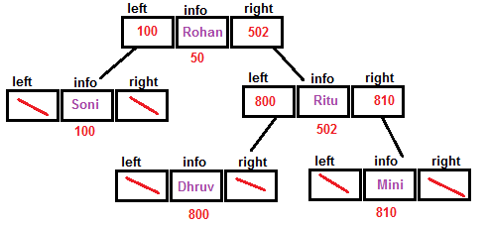
Each node of struct node
type will be as:
struct node{
  struct node *left;
  char info[20];
  struct node *right;
} ;

Slide 47
THANK YOU…
You can mail me your queries at :
gunjan.m19@gmail.com

